Slide 1
Being a black student at a private school
Jasmine Walker

Slide 2
Notes:
US Department of Education

Slide 3
Purpose: To Raise Awareness
Take a closer look at the demographics
Making others aware of stereotypes and microaggressions that impact black students in Private Schools and Universities
Lack of black representation in faculty and administration
The importance of Safe Spaces
Helpful resources
Use of coping mechanisms
Notes:
For this autoethnography project we are required to have 10 pages of contentment. 5 webpages will be: my review of literature, infographic, artifact analysis, and two interviews. The final pages will be the following:
1. A slideshow showing the progress of the project
2. A page of Definitions of phrases and vocabulary frequently used throughout the site
3. A highlight page on California State University in Los Angles, and how the creation of the Safe Space really benefitted students
4. A virtual infographic video
5. A page discussing labels, and why people should divert their attention from them
Video of this great spoken word that was used
6. List of Positive Affirmations

Slide 4
Example: Microaggressions
https://www.youtube.com/watch?v=8rls9Y_jigs
Notes:
Start at 30 seconds, then skip to 2:30

Slide 5
Interviews
Jillian (friend, Northwestern University First Year)
  attended private school for K-12
  now attends a private university
Kiana (friend, Emory University Senior)
  attended public school for K-12
  now attends a private university

Slide 6
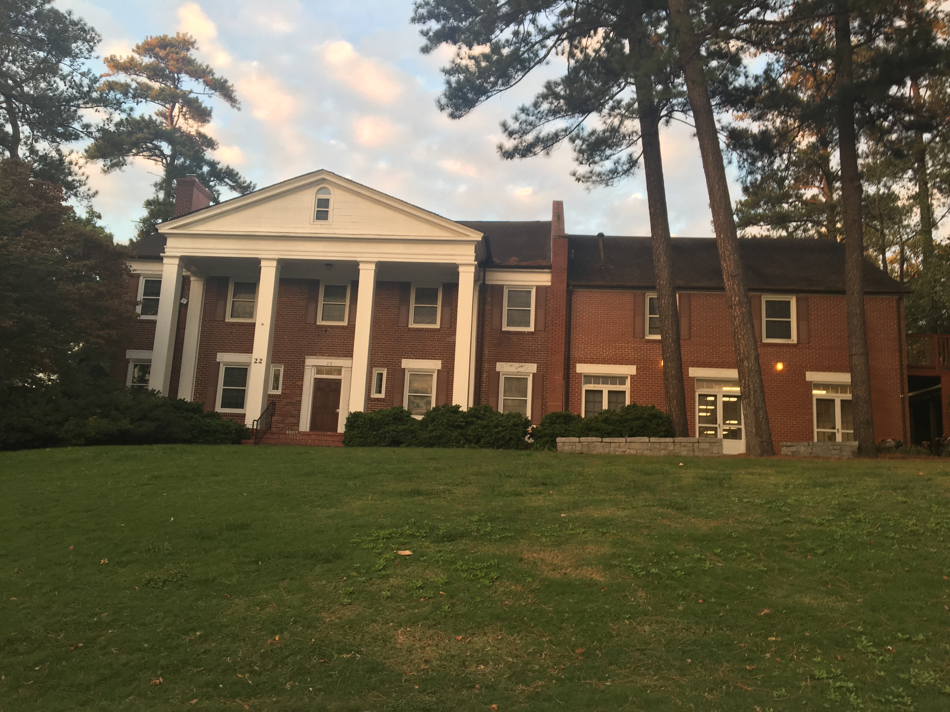
Places and Spaces That Will Be Highlighted
Emory Black Student Alliance House
Emory Black Student Union
Notes:
BSA house created in order to: “Maintain Black identity and cohesiveness on the Emory University campus
Promote recognition of a conscious African American culture and heritage
Serve as a place for the study and evaluation of Black ideals and goals.”
http://www.emory.edu/CAMPUS_LIFE/ebsu/

Slide 7
Sources
https://collegescorecard.ed.gov (https://www.ed.gov - US Department of Education)
Bitterman, A., Gray, L., and Goldring, R. (2013). Characteristics of Public and Private Elementary and Secondary Schools in the United States: Results From the 2011–12 Schools and Staffing Survey (NCES 2013–312). U.S. Department of Education. Washington, DC: National Center for Education Statistics. Retrieved 10 Sept. 2016 from http://nces.ed.gov/pubsearch.
http://www.emory.edu/CAMPUS_LIFE/ebsu/

